Slide 2
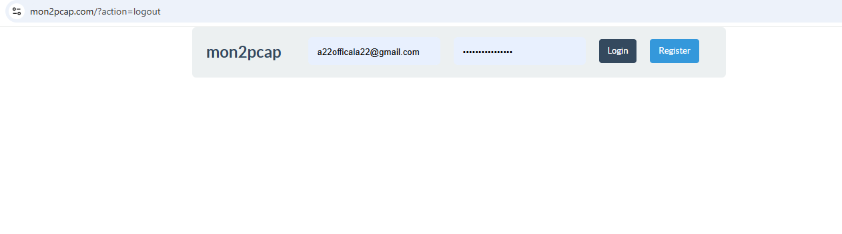
Login Page
Enter your user
name and password

Slide 3
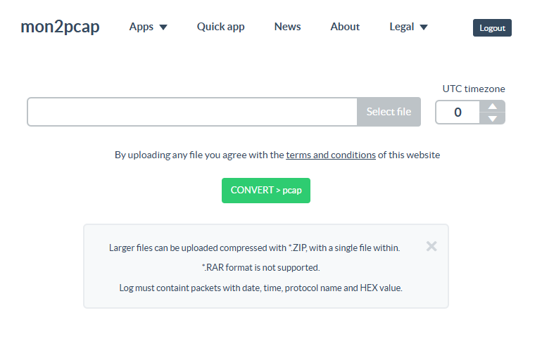


Home Page
Mon2pcap is used for converting the .txt logs file into proper readable format.
Browse the .txt log file to convert it into PCAP logs.
After converting download the file
1
2
Select file
CONVERT > pcap

Slide 4
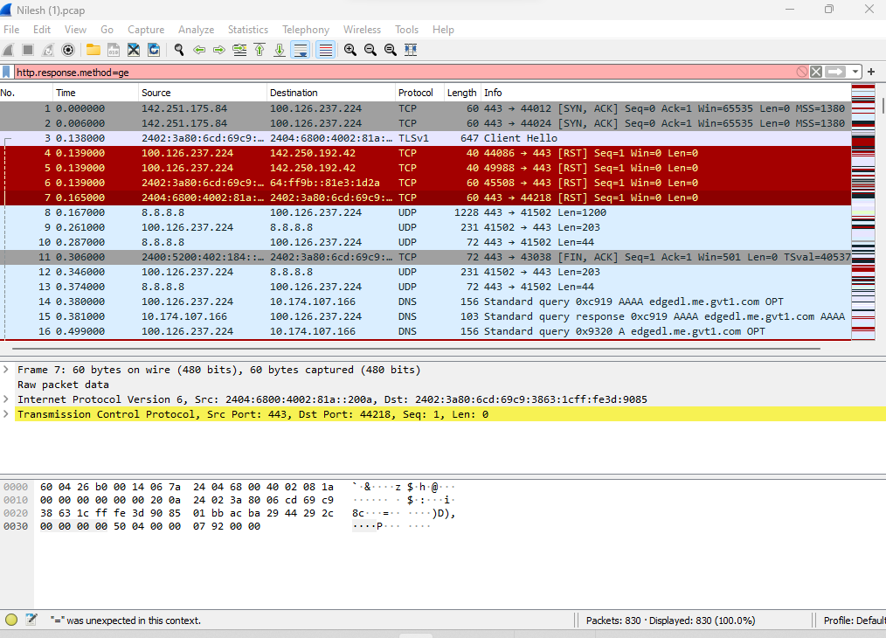
PCAP Traces
After downloading the file from mon2pcap.
First, you need the Wireshark application to see the converted logs.
In the logs, you will able to see the Source IP, destination IP, and the communication flow of the protocol

Slide 5
Thank you !

